Slide 1
Robotic surgery
Stella Ledakis

Slide 2
History
Victor Scheinmann created the PUMA 560 in 1978 →to guide a needle for a brain biopsy during a neurological procedure
AESOP 1000 in 1994→first device to hold a laparoscopic camera
AESOP 2000 in 1996 and the AESOP 3000 in 1998→ robot gained voice control and seven degrees of freedom to resemble a human hand.
ZEUS in 1998 → the surgeon sits on a console that is separated from the robot and performs on the patient in this telepresence surgical system

Slide 3
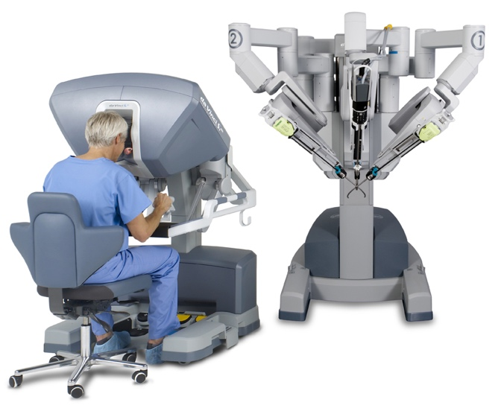
Da vinci surgical system
3 main parts:
the vision carts which contain the dual 3-chip camera and a dual light source
the master console where the surgeon is position
the transportable cart where the camera arm and the 2 instrument arms

Slide 4
How it works
Surgeon observes the patient from the console
A small 3D camera and a dime-sized surgical instruments are placed inside the patient through a tiny incision
The surgeon starts operating on the patient using the foot controls and the console’s hand to control and move the robotic hands
The surgeon’s team and the surgical technicians are clos e to the operating table to make sure eveyrhting runs smoothly

Slide 5
Advantages and disadvantages
Advantages
Precise movements
Enhanced visualisation
Longer and complex surgeries
Faster recovery
Disadvantages
High cost
Depends mostly on technology
Not every one has access
Doesn’t work for every type of surgey

